Slide 1
KurTan Website!

Slide 2





Home People; Publications; Projects; Contact; Lab meetings
Notes:
Add description of the lab somewhere here… Header of KurTan Lab. No navigation bar here.

Slide 3



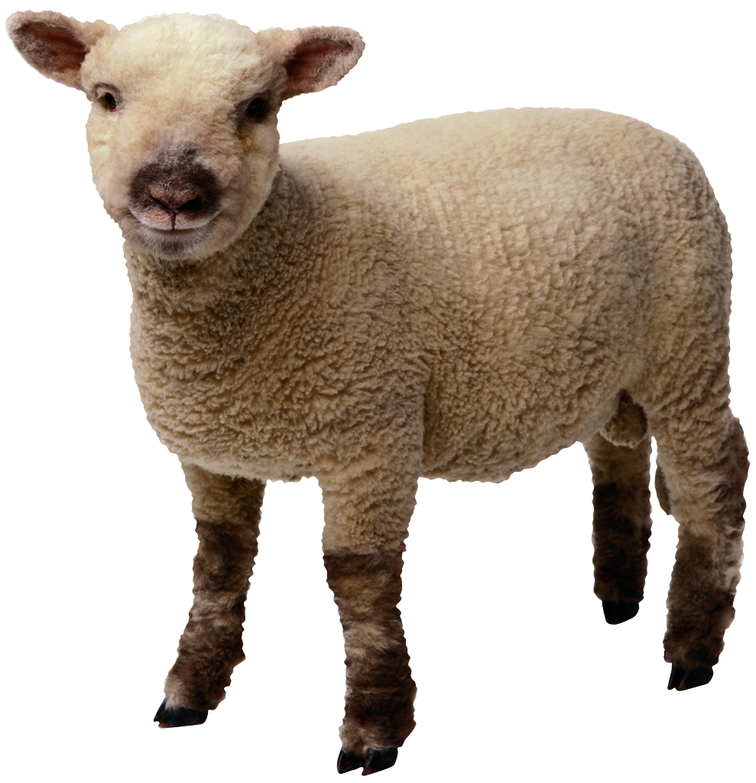
People
Name -Name
Contact info -Contact info
Name -Name
Contact Info -Contact Info
Notes:
For the bio, scroll over the name and then a window will pop out
-Want to include Pis, Grad students, Post-Docs, Under Grads, Collaborators, Alumni
Add a side navigation bar

Slide 4
Publications
Topics
Spoken Word Recognition
Sentence Processing
Prosody
Experimental Semantics
Language Acquisition
X Spoken word |  | X Sentence
 | X Prosody
X Experimental |  | X Lang Acq

Slide 5
Publications cont’d
In Prep
--------
Submitted/ Under Review
---------
2014
----------
----------
2013
----------
2012
----------
etc
Notes:
See standford cognition language website so the icons.

Slide 6
Lab Meetings
September
October
Sept 8th Topic |  | Sept 15 topic
 | X
Sept 22 topic |  | Sept --- topic
Date topic |  | Date topic
 | Date topic
Date topic |  | Date topic
Notes:
To get to this point have a previous link before hand such as Fall 2014 spring 2015 etc and then it will come this visual world paradigm look with clicking on the links to he topic/ and paper there

Slide 7
Contact
Email |  | Phone
 | Lab Address
To Participate |  | To Apply
Notes:
To apply (document) downloaded to someone’s computer and email us back the application

Slide 8
Projects
Picture ________ ________ |  | Picture ________ ________
 | Picture ________ ________
Picture ________ ________ |  | Picture ________ ________
Notes:
When scroll over the project then it will give more info about the project

